Slide 1
Immigration for Businesses and Business Leaders
Kathleen Gasparian
www.gasparianimmigration.com
504.262.9878
kathleen@gasparianimmigration.com

Slide 2
When does a business deal with Immigration Issues?
Compliance with the law prohibiting the employment of unauthorized aliens/ employment verification
Has traditionally been a Federal issue, but recent trend is for State legislation as well.
Choosing to sponsor an employee for temporary or permanent immigration status
Mergers and Acquisitions
Challenges specific to certain industries

Slide 3
Definitions
Citizen: Fully admitted to our political and economic community.
Immigrant: Legally come to the U.S. to live and work permanently.
Non-immigrant: Come to the U.S. for specific purpose, limited period of time.
Other: Live in U.S. with government permission, but are neither non-immigrants nor immigrants.
Undocumented: Enter without inspection or by fraud, or stay has expired.

Slide 4
Ways to Come to the United States
Family
Employment
Asylees/Refugees
Visa Lottery
Investment
Special Programs

Slide 5
A growing issue
A nation of immigrants
The current face of immigration
Issues/decisions that have roots in immigration have impact on many other areas.
The 5th Circuit is uniquely situated to address immigration issues.

Slide 6
A growing issue
Charged political issue
The law needs changing?
20+ years since last big change, 15+ since last meaningful relief
Current law difficult for businesses/ international corporations with foreign workers
The H-1B program
Concerns of brain drain/ competitiveness
Long waiting times for certain family based immigration
Enforcement at all time high
Highly backlogged courts
Lengthy detention without review
Executive action and agency policy
Expanded state and even municipal action

Slide 7
Some numbers to ponder
Using 2013 US Census Bureau’s American Community Survey
U.S. immigrant population is > 41.3 million or about 13% of total population
U.S. immigrants and their U.S. born children are about 25% of total population
Non-immigrant admission in 2013 was about 173 million
That includes est. 112 million admissions that are I-94 exempt
Of I-94 admissions, 90% are tourists admissions
Thus, workers, fiancés, and students make up a small portion of admissions
Approx. 9 million visas issued by DOS in 2013
Notes:
The vast majority (77 percent) of the 9.2 million nonimmigrant visas issued in 2013 were temporary business and tourist visas (B-1, B-2, and BCC visas). The next largest visa class (F-1, F-2, and F-3) was for academic students and exchange visitors and their family members, who comprised 6 percent of all nonimmigrant visas issued, followed by H visa categories for temporary workers and trainees and their family members (4 percent).
The distribution by region of the 9.2 million visas issued to foreign nationals in 2013 shows that the majority of temporary visas were issued to nationals from Asia (37 percent), South America (25 percent), and North America (22 percent, including Central America and the Caribbean), followed by Europe (12 percent), Africa (4 percent), and Oceania (0.6 percent).

Slide 8
Some numbers to ponder
990,553 foreign nationals became permanent residents in 2013
46% new arrivals
44% immediate relatives of US citizens
IR and other family based = 65%
Employment = 16%
Asylee and other = 12%
Lottery = 5%

Slide 9
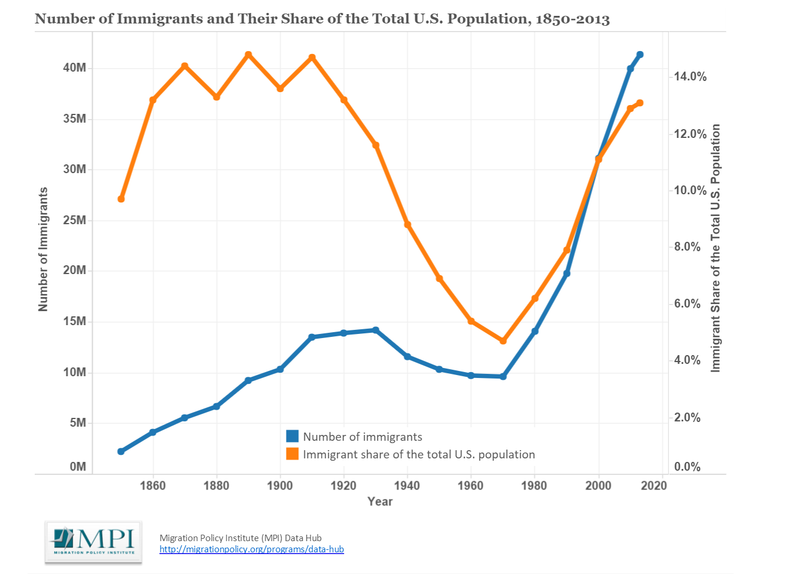
Notes:
Notes:
The term "immigrants" (also known as the foreign born) refers to people residing in the United States who were not U.S. citizens at birth. This population includes naturalized citizens, lawful permanent residents (LPRs), certain legal nonimmigrants (e.g., persons on student or work visas), those admitted under refugee or asylee status, and persons illegally residing in the United States.
Source:
Migration Policy Institute tabulation of data from the U.S. Census Bureau's 2010 - 2013 American Community Surveys and 1970, 1990, and 2000 decennial Census data. All other data are from Campbell J. Gibson and Emily Lennon, "Historical Census Statistics on the Foreign-Born Population of the United States: 1850 to 1990" (Working Paper no. 29., U.S. Census Bureau, Washington, DC, 1999).

Slide 10
Current immigration by the numbers
Mexican born immigrants account for app. 28%
Followed by India and China (5% each)
Then Philippines (4%), El Salvador (3%), Cuba (3%), and Korea (3%), as well as the Dominican Republic (2%) and Guatemala (2%)
Top ten countries = 60% of immigration
Late 1900s and 2000s rise in Latin American and Asian immigrants vs 1960s which was predominately European
i.e. 1960 Italy=13%, Germany =10%
Historically, immigrants settled in major cities/ limited areas. Currently, immigrants settle in more areas, more states, small towns, and rural areas (and still in major cities).

Slide 11
Numbers relating to the unauthorized
Number of undocumented/ unauthorized individuals in US is at about 11- 12 million
Number of children in US with one or more undocumented parent is at about 5 million
Number of removals from the US is down in 2015 compared to peak year of 2012 (2012 was over 400,000)
Numbers are still significant - 235,413
Border apprehensions and removals are down because the number of individuals coming to the border are down. Of the big number, 69,478 were interior removals.
98 percent of all ICE FY 2015 removals, or 230,715, met one or more of ICE’s stated civil immigration enforcement priorities.
The leading countries of origin for removals were Mexico, Guatemala, Honduras, and El Salvador.
Notes:
DHS reports that apprehensions at the Southwest Border in FY
2015 were as low as 337,117 – whereas in the
early 2000s, total apprehension figures were
regularly well over a million annually.

Slide 12
About Louisiana
Foreign born make up 3.9% of the population. Immigrants and the children of immigrants—account for 1.9% of all registered voters in the state.
Immigrants comprised 5.4% of the state’s workforce in 2013 (or 118,068 workers), according to the U.S. Census Bureau.
Latinos and Asians (both foreign-born and native-born) wield $10.2 billion in consumer purchasing power, and the businesses they own had sales and receipts of $5.2 billion and employed more than 33,000 people at last count
Louisiana was home to 182,559 immigrants in 2013, which is nearly the population of Jackson, Mississippi.
Unauthorized immigrants comprised 1.8% of the state’s workforce (or 40,000 workers) in 2010, according to a report by the Pew Hispanic Center.
In Louisiana, 87.2% of children with immigrant parents were U.S. citizens in 2009, according to data from the Urban Institute.

Slide 13
About Louisiana
In 2010, 7.6% of all business owners in Louisiana were foreign-born, according to the Fiscal Policy Institute, and 12.4% of business owners in the New Orleans-Metairie-Kenner metropolitan area were foreign-born in 2013, according to the Fiscal Policy Institute and Americas Society/Council of the Americas. Furthermore, over 1 in 4 (26.6%) of “Main Street” business owners—owners of businesses in the retail, accommodation and food services, and neighborhood services sectors—in the New Orleans metro area were foreign-born in 2013.
The federal tax contribution of Louisiana’s Latino population included over $478 million to Social Security and $112 million to Medicare in 2013. Foreign-born Latinos contributed over $197 million to Social Security and $46 million to Medicare that year.
Louisiana’s 6,976 foreign students contributed $175 million to the state’s economy in tuition, fees, and living expenses for the 2013-2014 academic year, according to NAFSA: Association of International Educators.
Foreign students also contribute to innovation in Louisiana. In 2009, “non-resident aliens” comprised 58.6% of master’s degrees and 31.1% of doctorate degrees in science, technology, engineering, and mathematics (STEM) fields, according to the Partnership for a New American Economy.

Slide 14
Immigration and Civil Law
Non-citizens can sue and be sued; enter into contracts, and have those contracts enforced against them. Immigration status, lawful or not, is usually irrelevant to these transactions.
Issues arise regarding the extent to which labor and employment statutory protections extend to undocumented workers
Very important to know exactly what your client’s status is and if client has used false documents

Slide 15
Sources of Law
Immigration and Nationality Act
8 CFR, and a sprinkling in 6, 20, 22, 28 and 42 CFR
Agency decisions (AAO)
Board of Immigration Appeals
Federal Courts

Slide 16
What agencies are involved?
Department of Homeland Security
USCIS
ICE
SEVP
ERO
HSI
CBP
Department of State
Department of Labor

Slide 17
Dealing with Compliance

Slide 18
Why is the employer required to verify work authorization?
The Immigration Reform and Control Act of 1986 (IRCA) created a comprehensive scheme prohibiting the employment of unauthorized aliens and established an extensive employment verification system.
8 USC §1324a unlawful to “hire, or to recruit or refer for a fee, for employment in the United States an alien knowing the alien is an unauthorized alien … with respect to such employment”
Civil & criminal sanctions
But – the same Act also established anti-discrimination provisions designed to keep employers from discriminating against people because of accent, national origin, a “foreign” look.

Slide 19
Who has to be concerned with IRCA?
Employer: Implementing regulation defines as a person or entity who engages the services of an employee for wages or remuneration.

Slide 20
Who has to be concerned with IRCA?
Employee: An individual who provides services or labor for wages or other remuneration. (Hired after November 6, 1986)
Not an employee: Casual Hire
Sporadic, irregular or intermittent employment (such as a domestic worker)
Maybe an employee?: Volunteer
There is a distinction between volunteer positions, which are charitable in nature, and unpaid employment for which a worker would have been hired if not for the unpaid worker
Not an employee: Owner with meaningful control vs. minority share owner
Notes:
Elements Determining Independent Contractor status:
Who supplies tools/materials?
Are services available to the public?
Is work done for other clients?
Does the individual have the opportunity for profit or loss as a result of the labor?
Has the individual invested in facilities for work?
Who determines the order, sequence and time that the work is done?

Slide 21
Independent Contractors
Not an employee: Independent contractor
An individual/entity who carries on independent business, contracts to do a piece of work according to his/her own means and methods and is subject to control only as to results. 8 CFR §274a.1(j)
Hot trend in enforcement:
challenging Employer’s classification of individual as an independent contractor
Can’t use classification of independent contractor to get around knowledge of lack of authorization

Slide 22
Basis for U.S. work authorization
Citizenship or Nationality
Through U.S. Citizenship and Immigration Services (USCIS)
Employment Incident to Status for Any Employer
Employment Incident to Status for Specific Employer
Others who can apply for work authorization from USCIS

Slide 23
The I-9 Implements the Requirements of IRCA
Must complete an I-9 even if also using e-verify
New form as of 3/18/13 – using an old form is a substantive violation
Must complete for all employees hired after November 6, 1986.
And for all re-hired employees who have not been working for the Employer for more than 12 months.
Rising numbers of I-9 compliance audits
Purpose is to establish identity and work authorization
Not a screening tool
Recent case involving 7-Eleven: no other scheme or system” an employer wishes to use may “circumvent or replace the Form I-9 completion and retention requirements…”

Slide 24
Avoiding Discrimination Claims in the I-9 process
IRCA established anti-discrimination provisions designed to keep employers from discriminating against people because of accent, national origin, a “foreign” look and also prohibits document abuse.
How is this achieved: Uniformity, Uniformity, Uniformity
Avoid treating international employees differently.
Employee should always be given the choice of what documentation to present.
You cannot ask to see specific immigration documentation. (But, may have a duty to verify status and in the e-verify context may have need to see/ request documentation).
Do not over-document – stay on one side or the other of the “documentary line” dividing List A documents from List B and C.

Slide 25
When Must the I-9 be Completed?
Section 1 – Completed by the employee at the time employment begins
Section 2 – Completed by the employer by the 3rd day of employment. (By the 1st day of employment if the individual will work 3 or fewer days)
The Monday – Thursday rule per DHS publications
Section 3 – Completed by the expiration date of the foreign national’s work permission

Slide 26
Section 1
To be completed by the employee
Employer’s role in Section 1 is to review it for completeness. Make sure the employee signs and dates the form. If not, employer assumes liability for false statements in Section 1
One of the most common errors

Slide 27
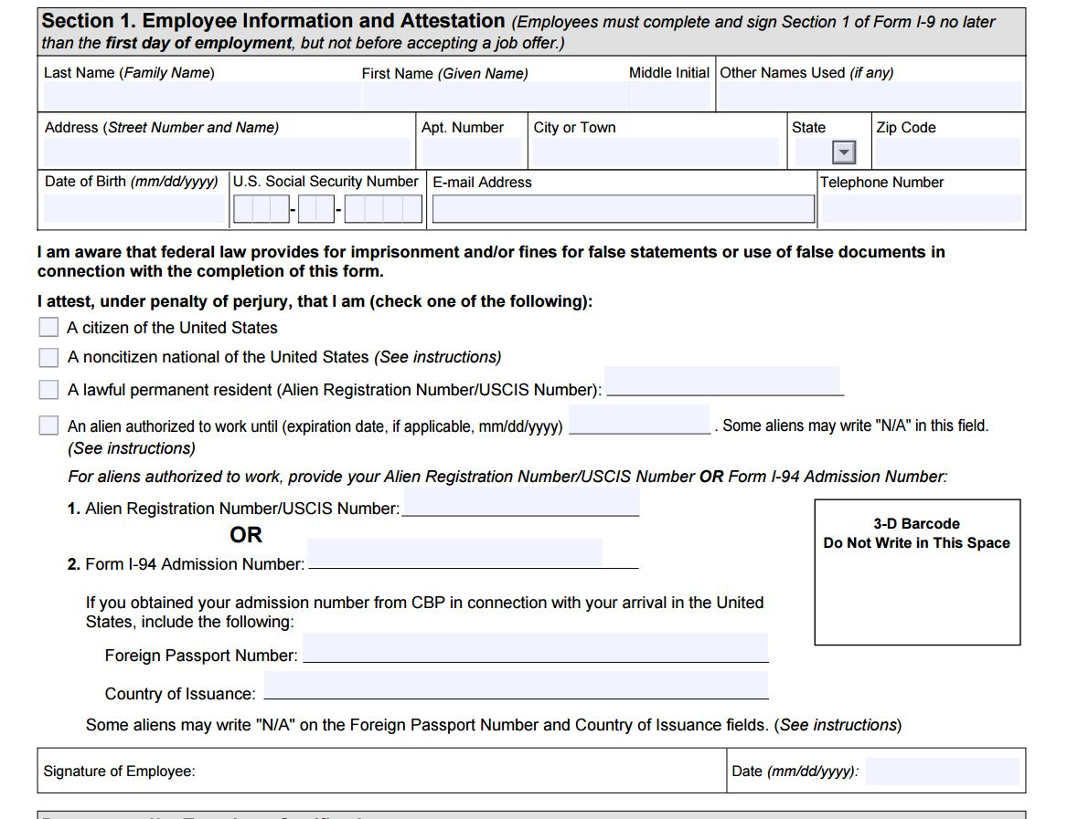

Slide 28
Section 1 problem areas
Social Security Number: Often foreign nationals have applied for, but do not yet have, a Social Security number. They should write “pending” in the box. Do not leave this item blank; the blank space can be considered to be a technical paperwork violation. The form should be updated once the SSN is received. Any changes should be initialed and dated.
HOWEVER – if you are using e-verify, a SSN is mandatory for e-verify.
Failing to have section 1 signed is a substantial violation
Failing to have Employee check a box regarding status is a substantial violation
Leaving any of the items blank

Slide 29
Employer’s Role in Section 2
Establish the identity of the employee
Verify the person is who he/she says he/she is by looking at the photo ID and seeing if it relates to the person
Verify employment eligibility
The person who completes section two must be the person examining ORIGINAL documents. It is not sufficient to exam copies of documents. US v. ESSG, II
Verification must occur in-person; no provisions for verifying identity via Skype, etc.
Failure to timely complete section 2 or sign can be substantive violation- don’t backdate!
In Hartmann Studios, the employer failed to sign the Section 2 certification on 800 occasions. This led to a penalty of over $600,000.

Slide 30
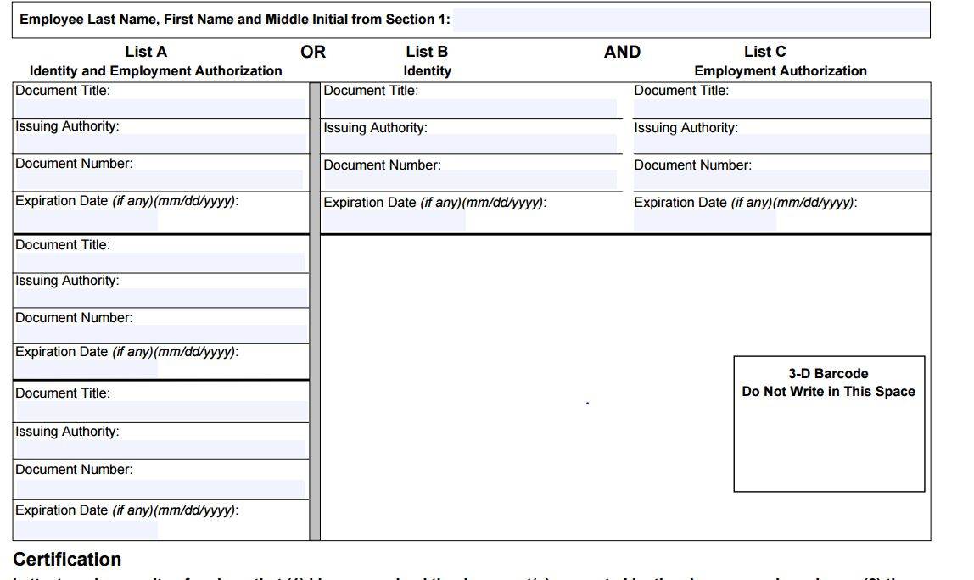

Slide 31
List A vs. List B and C
List A – establish BOTH identity and work authorization
US passport; green card; unexpired work card; foreign passport and valid I-94 (either old paper version or new printed copy of online version)
List B – Identity only
Driver’s license, state ID, school ID, military card, etc.
List C – work authorization only
SS card

Slide 32
Reviewing the Documents
If documents appear to be genuine, you must accept them, unless you have knowledge to the contrary.
However, if you have knowledge that they are not right, you must explore further.
When the employer believes that a conflict is presented between the employee's statements regarding employment eligibility in Section 1 of the I-9 form and the documents presented by the employee under Section 2, the employer may need to inquire further, but must be extremely careful not to engage in an unfair immigration-related employment practices.

Slide 33
Copying Supporting Documentation
If copies are going to be made, they must be made of documents presented by ALL employees, not just the foreign ones.
If using e-verify, may be required to make copies of certain documents.
Copies of documents must be kept with the I-9s.

Slide 34
Section 3 of the I-9
Must be completed on or before the expiration date of the employment authorization indicated in either Section 1 or Section 2 of the original I-9.
Employee need only show documentation establishing continued ability to work – identity documents not needed as employer should already “know” employee.
Employer must record information on document(s) presented.
May need to re-verify if employee presented evidence of temporary work permission.
Not everyone must be reverified. I.e. – do not reverify “green card”
Notes:
Reverification

Slide 35
Retention calculation
Retain at least 3 years after the date of hire, or one year after employment ends, whichever is the later date.
A - Date the employee began work for pay ?
Line 1 = 01/01/1995
B -Add 3 years to the date on line 1.
Line 2 = Line 1 plus 3 = 01/01/1998
C -The date employment was terminated
Line 3 = 01/01/1996
D - Add 1 year to the date on line 3.
Line 4 -Termination plus one year = 01/01/1997
E –Which date is later B or D (Line 2 or 4)?
The employer must retain Form I-9 until the date on Line C.

Slide 36
I-9 training and compliance
DHS regularly providing free webinars
Good Q and As available on common I-9 issues
E-verify newsletter
www.uscis.gov/I-9Central
Employer is not entitled to cultivate deliberate ignorance or avoid acquiring knowledge
Government is encouraging internal I-9 audits

Slide 37
E-Verify
A joint program between DHS and the SSA that uses an internet based automated system to verify the employment authorization of all newly hired employees.
The system compares information in the employee’s I-9 form against SSA and DHS databases.
It does not replace the I-9 system.
Required for certain federal and state contractors.

Slide 38
A few things about e-verify
E-Verify does not excuse you from completing I-9s
SSN – I-9 not required; E-Verify mandatory
E-Verify – List B document must contain a photo
For both, may not ask to see a document that verifies A#, but if presents a green card (I-551) or EAD (work card) for the I-9, then MUST make a copy of it for E-Verify photo screening tool
Establishes a rebuttable presumption that Employer has not knowingly hired an unauthorized alien
Evidence of good faith compliance with IRCA
Protections against criminal and civil liabilities
Reduce risk of employing unauthorized workers

Slide 39
Self-Check
Self-Check is a free online service that lets workers verify their own eligibility to work in the U.S., and is;
Now accessible to residents of 21 states (includes LA) and D.C.
Check USCIS.gov/SelfCheck for a complete list of states

Slide 40
E-verify Email Notification
Recently, E-Verify announced e-mail notifications to employees when there is an information mismatch if employees voluntarily provide the information.
The revised I-9 form allows employees to provide email.
If a Tentative Nonconfirmation (TNC) is received, employees who have provided their e-mail address will be directly notified of the TNC.
Employers will notice a new data field in E-Verify asking for the employee’s e-mail address. When the employee provides an e-mail address on Form I-9, employers are required to enter it into E-Verify. The new e-mail notification process does not replace the current TNC process. Employers are still required to notify employees of TNCs and their right to contest.

Slide 41
Penalties
Since 2009: focus on auditing and investigating employers to reduce demand for illegal employment
Also following priority enforcement memos – looking at industry related to national security
knowingly hire and continuing to employ
= $375 to $16,000 per violation
substantive violations
= $110 to $1,100 per violation.
In determining penalty amounts, ICE considers five factors: the size of the business, good faith effort to comply, seriousness of violation, whether the violation involved unauthorized workers, and history of previous violations.

Slide 42
Trends
ICE collects about $16 million per year
2004 = 3 audits
2008 = 500 audits
2012= 3,000 audits
OCAHO lowered ICE proposed penalties on average by 32% in 2015
Adjusted to mid-range of penalties
Looked at size of company and ability to pay
Major industries for enforcement
Manufacturing/ Food Processing
Hospitality

Slide 43
Trends
Small Business
More lenient in fines
Defined as less than 100 employees
Ethnic restaurants tend to be a regular target for I-9 audits
In determining the size of the business, the actual number of employees working at the time of the audit should be used. The restaurant industry has a high turnover rate so an aggregate number over a period of time should not be used to determine number of employees.
Proportionality is critical part of setting fines
Balancing the size of the business and the egregiousness and number of violations. Trend to reduce fines when ICE is seeking maximum penalty.
Increased penalties for knowingly hiring people without work authorization
Lowering penalties for paperwork violations
Missing or defective I-9s do not prove a lack of good faith.

Slide 44
Trends
Cooperation of DHS with other agencies at all time high
Coordinating with criminal prosecution at all time high
Cooperation with state agencies at all time high
Expansion of E-Verify
State legislation
Required for federal/ state contracts
Required/strongly encouraged after audit
Future biometric capture
Important that all employers be aware of requirements, conduct audits, keep paperwork in order

Slide 45
Recent I-9 Violators
Danny’s Carwashes in Arizona
Began with an I-9 audit that revealed 942 out of 1,912 employees had insufficient or ineligible documents relating to work authorization
Owners, corporate management and store managers targeted for criminal prosecution including a pattern or practice of knowingly hiring undocumented workers, aggravated identify theft, and conspiracy
Subway franchise, drywall company and metal-finishing company all fined approximately $30,000 for not timely filing I-9s

Slide 46
Additional ramifications of violating IRCA
8 USC 1324a(f) criminalizes “pattern or practice” of hiring, recruitment, referral for a fee or continuation of employment of persons unauthorized to be employed; $3,000 fine and/ or 6 months for EACH unauthorized employee. 8 CFR 274a.10
Traditionally, “pattern or practice” thought to refer to entities with prior violations/warnings.
Recently, “pattern and practice” has been interpreted by ICE as meaning hiring more than one unauthorized individual.
There is also a criminal penalty for hiring 10 or more aliens in a 12-month period knowing they are not authorized to work and that they entered the U.S. in violation of INA §274.

Slide 47
Other Punishment
Federal Contractor Debarment
Other possibilities include aiding and abetting, conspiracy, money laundering, fraudulent use/ possession of SSN/ cards. Additional exposure could include asset forfeiture for felony convictions. 18 USC §982(a)(6)(a).

Slide 48
I-9 and E-verify as a state issue
Many states (LA included) have passed state laws encouraging or requiring e-verify.
Often, state law conflicts with federal law – or does not use the same language, etc.
E-verify often required to do business with the state or to for licensure

Slide 49
Setting Hiring Policies
I-9 and e-Verify are NOT screening tools. The Execution of the I-9 at the interview is not appropriate unless applicant hired. 8 CFR 274a.2(b)(1)(i)(A).
Best practice: treat all job applicants exactly the same throughout interview and hiring process.
Do not ask extra or unusual questions of foreign born applicants, or request extra documents from them.

Slide 50
Is it okay to….
Have a policy of only hiring U.S. citizens?
NO. The law prohibits employers from hiring only U.S. citizens or lawful permanent residents unless required to do so by law, regulation or government contract.
Have a policy of preferring aliens?
NO. The law prohibits preferring to hire temporary visa holders or undocumented workers over qualified U.S. citizens or other protected individuals.

Slide 51
Is it okay to….
Have a policy that we do not support H-1B petitions, we do not hire individuals on OPT, or support the process for permanent residence?
From a legal standpoint, yes, but probably not from a practical standpoint.
Better to have a flexible policy that can respond to the needs of the organization and changing market
Can’t have a policy that is discriminatory in practice, i.e. only sponsor nationals of country X.

Slide 52
But, I want to know what we are getting into before we make an offer
It is okay to ask some questions before an offer is extended. Best practice is to have a written questionnaire or formula that is followed every single time. Don’t wing it!

Slide 53
What not to ask
Are you a citizen/ permanent resident of the US?
How did you get your citizenship/ residence?
What is your status?
What is your home country?
What is your native language?
Do you intent to become a citizen?
Do you have an unlimited authorization?
Under IRCA employers cannot reject “protected individuals” because of time limited employment eligibility, even if the remaining eligibility is short. For example, asylees may have a work card that only has facial validity for another few months. However, asylees are able to obtain automatic extensions of work authorization and are, protected under IRCA as “intending citizens” of the United States. Thus, the better practice is never even to inquire as to the remaining time left on work authorization.

Slide 54
Okay to ask…
Acceptable question to determine if there is a problem: Are you authorized to work in the US for any employer?
If the applicant answers “yes” you may then ask
will you require now or in the near future employment visa sponsorship (i.e., H-1B visa)?
If answer to the acceptable question is “no” or equivocal, then employer has duty and right to investigate immigration status further. US v. Walden Station, Inc. 8 OCAHO 1053 (2000); Mester Mfg. v. INS, 879 F. 2nd 561 (CA 9 1989).
Additional acceptable questions in this case:
What is your immigration status?
Do you have a work permit, work authorization or work visa?
When does it expire?
How was it obtained?
May I see it?

Slide 55
ICE Visit – I-9 What will happen
ICE must provide at least three days notice to the employer prior to inspection unless there is a criminal or civil subpoena. 8 C.F.R. §§274a.2(b)(2)(ii)
DHS regulations provide that no subpoena or warrant is required for an inspection and that "any refusal or delay in presentation of the Form I-9 for inspection is a violation of the retention requirements as set forth in §274A(b)(3) of the Act." 8 C.F.R. §§274a.2(b)(2)(ii)
ICE may come in person to deliver the request; should be in writing and explain all requested records.
Request is usually for I-9s, certain information about employees, payroll records, etc.

Slide 56
I-9 compliance as a PR issue
Are the businesses you are partnering with or contracting out to I-9 compliant?
Yes, you can and should have a clause in your contracts allowing you to check their I-9 records/compliance
Do you know what your front line managers/ those with hiring authority are really doing?
What’s the real message within the company?

Slide 57
I-9 issues in mergers and acquisitions
Under current law, a “continuing employer” is not required to complete new I-9 forms on behalf of newly acquired employees if such employees have a reasonable expectation of employment at all times. In the merger or acquisition context, a “continuing employer” is defined broadly as an “employer who continues to employ some or all of a previous employer’s workforce in cases involving a corporate reorganization, merger, or sale of stock or assets.”
However – if you don’t complete new I-9s, assume liability for any problems
Distressed? Previous contact with enforcement? Industry?

Slide 58
Your driver’s license and Real ID
REAL ID has been around for a long time
States have had the option to issue IDs that comply or not
Louisiana (and many other states) has gotten extension of deadline to have REAL ID compliant documents
Starting in September, LA residents will have the option to get a license that is REAL ID compliant
Starting in 2020 – every air traveler will need REAL ID compliant identification to fly

Slide 59
Current challenges in Employment Based Immigration

Slide 60
When does an Employer deal with Immigration Issues?
Choosing to sponsor an employee for temporary or permanent immigration status
Compliance with the law prohibiting the employment of unauthorized aliens/ employment verification
Has traditionally been a Federal issue, but recent trend is for State legislation as well.

Slide 61
Who Pays? Non-immigrant
H-1B prevailing wage balance; err on the side of caution – employers pay fees.
H-2B seasonal workers
J-1 programs
Proposed reform? New work visas?

Slide 62
Common Non-Immigrant Issues for Employers
After graduation students on F-1 visas may receive a year or more of work authorization
Spouses of certain visa holders may receive work authorization
TPS – Temporary Protected Status. Not technically a non-immigrant status. Permission to live and work in the US. Will have an employment authorization document

Slide 63
F-1 Students
Significant changes in regulations regarding STEM Extension Optional Practical Training
Available for graduates in STEM fields
Increases time available for OPT
Employer Responsibilities for STEM Extension OPT
Be enrolled in E-Verify and remain in good standing.
Report material changes to the STEM OPT student’s employment to the DSO within 5 business days.
Implement a formal training program to augment the student’s academic learning through practical experience.
Provide an OPT opportunity that is commensurate with those of similarly situated U.S. workers in duties, hours, and compensation.
Complete the Form I-983, Training Plan for STEM OPT Students. In this form, you must attest that:
You have enough resources and trained personnel available to appropriately train the student;
The student will not replace a full- or part-time, temporary or permanent U.S. worker; and
Working for you will help the student attain his or her training objectives.
U.S. Immigration and Customs Enforcement may visit your worksite(s) to verify whether you are meeting the STEM OPT program requirements, including whether you are maintaining the ability and resources to provide structured and guided work-based learning experiences for the STEM OPT student.

Slide 64
B-1/B-2: Visitors for Business or Pleasure
Rules and regulations are ancient; do not contemplate our ease of telecommuting or work from anywhere
Unclear as to what constitutes “employment” that would lead to violation in our current culture
Recent rise in agency enforcement especially on issues of B-1 in lieu of H-1B in certain industries

Slide 65
H-1B visa – Temporary Professional Workers
For professional-level workers who are coming to work for a U.S. employer in a “specialty occupation”
Examples : chemists, biologists, engineers, physicists, software developers, systems analysts, accountants, economists, architects
Current challenges
Limited number available - 85,000 per year (65,000 + 20,000)
Demand exceeds supply!!
Narrow interpretation of which employer fall out of the cap count
Narrow interpretation of specialty occupation?
Rise in litigation
Foreign workers suing over wage issues
US workers suing over wage issues, unfair employment practices

Slide 66
Choosing to sponsor for H-1B
Do I have to show there are no US workers for the H-1B?
No. No recruitment required. Special qualities not required. Two ten day postings or letter to union are for notification only.
Will I have a problem with immigration?
No. CIS does conduct site visits with most H-1B employers. This is to verify the contents of the petition, and does not lead to an I-9 audit or other headaches.
Will everyone know?
Maybe – some of it is public record.

Slide 67
Choosing to sponsor for H-1B
Do I have to disclose our finances?
To USCIS, most of the time just gross and net income. To the employee, no.
Is it a lot of paperwork?
Not really. A few signatures, two ten day postings, no advertising; attorney can simplify process.
Do I have to post the alien’s wage?
You can post a range of wages

Slide 68
Choosing to sponsor for H-1B
Is this an employment contract?
NO. Does not affect at will nature of employment.
We are going to invest all this time and money, only to have the person leave.
Can have a one way employment contract – employee has a penalty if leaves before a certain date, but employer retains the right to employ at will.

Slide 69
Potential issues
Liability to foreign national if fail to pay wage/ comply with H rules and regulations
Liability to DOL/ CIS if fail to comply
Liability to US workers for displacement

Slide 70
O-1 Requirements
Alien must be “one of the small percentage who have arisen (sic) to the very top of the field of endeavor.” Since about March 2002, USCIS has consistently enforced this definition
Position must require utilization of extraordinary ability
Employment limited to petitioning employer
No “portability” if in O status, upon filing of new petition, until new petition approved

Slide 71
TN Visa
Available to citizens of Mexico and Canada
Occupation must appear on NAFTA list
Given in one year increments, no limit
Canadians need only present one year job offer, credentials at border or airport for admission
Mexicans must follow H-1B-like procedures
Extensions may be done within US

Slide 72
H-2B Visas – Temporary Visas for Temporary Positions
Employer must demonstrate a temporary need for workers: one-time occurrence, a seasonal need, a peakload need, or an intermittent need
Must prove there are no U.S. workers
Limited availability – demand far exceeds supply and made worse by removal of returning worker exceptions

Slide 73
L-1: Intracompany Transferees
Allows multinational companies to transfer key employees to related entities in the U.S.
Multinational companies may use L to transfer managers/executives (L-1As) and individuals with specialized company knowledge (L-1Bs) who have worked for the company abroad for one of the prior three years.
Some large companies with numerous transfers have “blanket L” programs which pre-qualify related entities and streamline L process.
L-2 spouse may obtain unrestricted work authorization.

Slide 74
E Visa: Treaty/Trader Visas
U.S. company must have nationality of a treaty country
Employee must be a national of the same treaty country
Employee must be engaged in managerial duties or have essential skills
E visas granted for an initial period of up to 5 years and subsequent extensions are available (Petitions granted 2 years)
Spouses eligible to apply for employment authorization

Slide 75
What you need to know about Permanent Residents
Difference between Conditional Resident and Permanent Resident
CR coded on card
Can lose residence
Actions influence ability to apply for citizenship
Taxes
Criminal behavior

Slide 76
Employment Based Immigration
Preference System
Limited Number of “green cards” available every year. Divided according to preference category and country.
Governed by the visa bulletin
Sometimes moves forwards, sometimes backwards

Slide 77
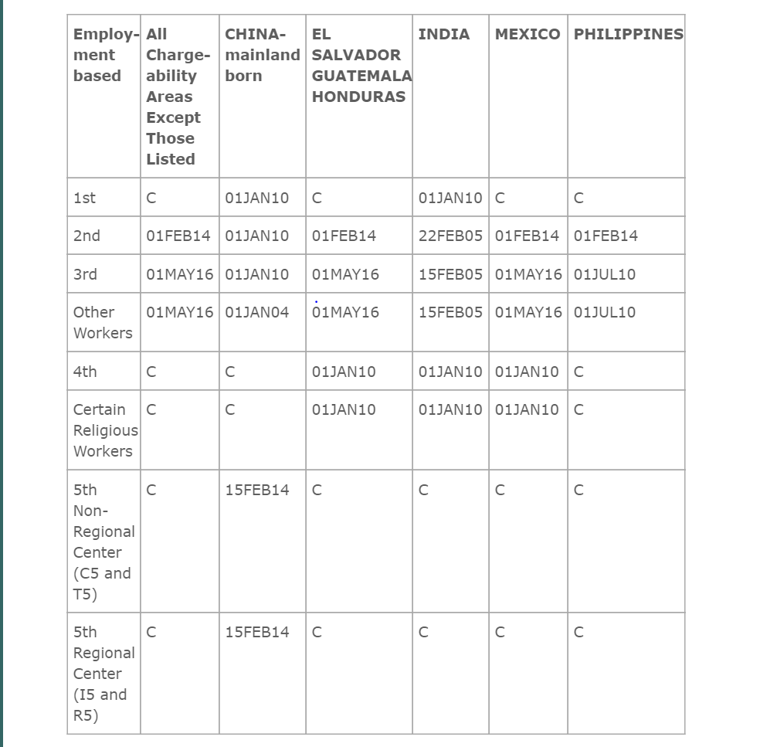

Slide 78
Challenges in immigration through employment
Unprecedented delays in visa availability for advanced degree positions, but shorter delays for other positions
Exceptionally long wait times for nationals of China and India
Legal system that is difficult for new industry models/ start-ups

Slide 79
Immigration through Employment
Step 1
The employer demonstrates to the DOL that there are no qualified US workers (called PERM)
For certain jobs/positions/aliens this step can be skipped.
Step 2
Petition filed with USCIS (the I-140)
In most cases, filed by the employer. Sometimes, the alien can self-petition.
Step 3
The application for permanent residence
There has to be a “spot” available

Slide 80
EB-1 (“Priority Workers”)
Quota approx. 40,000
A. Extraordinary ability or achievement in sciences, arts, education, business, or athletics
B. Outstanding professor/ researcher
C. Certain multinational executives/ managers
Can skip showing no US workers

Slide 81
EB-2 Advanced Degree Professionals & Aliens of Exceptional Ability
Professional with advanced degree
Aliens of exceptional ability
National interest waiver of job offer and labor certification for prof. with advanced degree or alien of exceptional ability
Depending on sub-category may or may not have to show no US workers

Slide 82
Eb-3 skilled workers, professional and other workers
Requires labor certification process except for pre-approved categories (nurses, therapists, sheep herders)

Slide 83
EB-4 Religious Workers
Job offer in U.S. from “bona fide nonprofit religious organization”

Slide 84
Eb-5 employment creation
Approx. 10,000 /max. 3,000 targeted areas
New business (established after Nov. 29, 1990)
Rural area or area with 150% unemployment rate: 500K, 10 full time jobs
Urban area, or area with less than 150% natl. u/e rate: 1 million, 10 full time jobs
Existing business: invest required amt., increase net worth by 40%, and create 10 new jobs.
Targeted area: can show indirect job creation, eg, contract workers.
CR for two years.

Slide 85
Industry – health care
Nurse shortage
Difficulty of meeting shortage with foreign workers – balance long and short term solutions
Physicians
Large number of physicians are foreign born need immigration sponsorship

Slide 86
Industry – start-up and tech
H-1B demand issues
Issues with foreign national having company ownership and using the company as basis for immigration
Country limitations for investor visa (no treaty with India, China, etc.)
Employment creation requires large investment and large number of employees

Slide 87
Industry – hospitality and labor
Abuse of the H-2B program and J-1 exchange program
H-2B program not responsive to real world needs

Slide 88
Intersection of Immigration and….
Mergers/ Acquisitions
Review for immigration issues
Employees on Non Immigrant Visas, Employees on the path to residence
Are you changing the nationality of the company?
Will the change in ownership percentage impact someone’s visa?
Import/ Export control
Do you have foreign nationals working with controlled tech/information?
PR concerns
Worker’s comp claims/ other liabilities?
Be careful how you approach this issue

Slide 89
Executive Action
November 20, 2014 President Obama announced a series of executive actions to address immigration system needs
Visa modernization and streamlining
Enhance options for foreign entrepreneurs
Streamline process for foreign workers and employer and still protect US workers
Expansion of optional practical training options for foreign students
Promote naturalization
Improvements to adjudication of family petitions including creation of provisional waiver program
Clarify enforcement priorities – create guidelines for exercising prosecutorial discretion in enforcement and prosecution (removal)
Formalization of deferred action – DACA and DAPA

Slide 90
A note on Executive Action - DACA
AKA the Obama Law or Executive Action
Original DACA August 2011
Executive Action, expansion announced November 2014
Lawsuit filed in December 2014, Texas v. US
Judge granted an injunction, in part
Went to SCOTUS – who tied
Not a green card. Does not provide a path to residence or citizenship.
DHS agrees not to remove the applicant
Defers the removal
The applicant can qualify for an employment authorization document
Good for two years
May be able to get a travel document?

Slide 91
A note on Executive Action - DACA
Must be under 31 as of June 15, 2012
Entered the U.S. before reaching the age of 16
Continuously resided in the U.S. since June 15, 2007
Physically present in the U.S. on June 15, 2012, and at the time of application
Entered without inspection or out of status as of June 15, 2012
Must be at least 15 to apply
Exception if in removal proceedings

Slide 92
A note on Executive Action - DACA
currently in school
graduated or obtained a certificate of completion from high school
obtained a General Education Development (GED) certificate
or are an honorably discharged veteran of the Coast Guard or Armed Forces of the United States;
have not been convicted of a felony, significant misdemeanor, three or more other misdemeanors, and do not otherwise pose a threat to national security or public safety.
significant misdemeanor = offense of domestic violence; sexual abuse or exploitation; burglary; unlawful possession or use of a firearm; drug distribution or trafficking; or, driving under the influence; or sentenced to more than 90 days.

Slide 93
A note on Executive Action –
Deportation/ Removal
High levels of deportation/removal incompliance with priority memos
Criminals, threats to security, etc.
Leniency for those with long residence, ties to US, humanitarian factors
Provisional Waiver program
Change in how individuals can seek forgiveness for time spent in the US without authorization making it easier for those with a path to permanent residence to complete that path
Small regulatory changes over time that bring small relief until reform

Slide 94
Essentials of Employment Law Immigration Law
Kathleen Gasparian
Gasparian Immigration
kathleen@gasparianimmigration.com
504.262.9878

